Slide 1
HOAC-HO-55260 SUPPLY, INSTALLATION, AND REMOVAL OF INTELLIGENT SMART CONTAINER LOCKS WITHIN THE TRANSNET OPERATING DIVISION OF RAIL INFRASTRUCTURE MANAGER (TRIM) FOR A PERIOD OF THREE (03) YEARS. TRANSNET INFRASTRURE MANAGER (TRIM) 11-DECEMBER-2025 10H00:AM
Presented By: Thivhonali Munyai
Notes:
Growth and Reinvent

Slide 2
Content
Discussion Presenters
Welcome and Introduction Thivhonali Munyai
Ground rules Thivhonali Munyai
RFP timelines Thivhonali Munyai
Returnable documents Thivhonali Munyai
Technical Requirements Lerothodi Moramang

Slide 3
Ground Rules
Respondents are to ensure that their speakers are on mute
RFP document will not be issued in this meeting
Late comers will be allowed however information will not be repeated for their benefit.
Questions will be allowed by raising a hand after every section of the presentation –Procurement and Technical Requirements.
The meeting is recorded, minutes and presentation will be published on NT e-tender portal.
Respondents are required to remain for the entire briefing session as important information pertaining to the RFP will be presented.

Slide 4
RFP Timelines
Timelines
Issue date 04 December 2025
Non-Compulsory RFP Clarification date 11 December 2025 at 10:00
Compulsory Site Visits KZN 20 January 2026 (Bayhead at 10H00am,Kingsrest 13H00 pm & 21 January 2026 (Island View 10H00 pm) 23 January 2026 725-756 Steve Biko Road at 10H00 am (Refer to Section 2 for details)
RFP Closing 10 February 2026 at 10:00 AM
Closing address Via electronic tender submission system
Please refer to Section 2, Paragraph 3 for guide on how to register and submit your company RFP online.
Each company must register their profile using its company details and use the corresponding registered profile to log an intent to bid as well as submitting any bid.
Transnet will not accept a bid or will disqualify a bidder who submits a bid in the Transnet e-tender submission through another bidders’/Company’s profile. In other words, each bidder must register the intent to bid and submit its bid through its own profile under the same company name that will eventually bid for the tender. No company shall submit a bid on behalf of another company regardless of the company being a subsidiary or holding company.
In case of a Joint Venture, any of the parties/companies to the Joint Venture may use its registered profile to submit a bid on behalf of the Joint Venture.

Slide 5
PROPOSAL SUBMISSION​
Log on to the Transnet e-Tenders management platform website (https://www.transnet.net) ​
Click on “TENDERS”;​
Scroll towards the bottom righthand side of the page;​
On the blue window click on “register on our new e-Tender Portal”;​
Click on “ADVERTISED TENDERS” to view advertised tenders;​
Click on “SIGN IN/REGISTER – for bidder to register their information (must fill in all mandatory information)​
Click on “SIGN IN/REGISTER” - to sign in if already registered;​
Toggle (click to switch) the “Log an Intent” button to submit a bid;​
Submit bid documents by uploading them into the system against each tender selected
Refer to Section 2, paragraph 3 on how to access and register eTenders_2

Slide 6
Scope of Requirements
Transnet is calling for proposals from experienced service providers with a proven track record for the supply, installation, and removal of intelligent smart container locks within the Transnet operating division of rail infrastructure manager (TRIM ) for a period of three (03) years Refer to Page 14-17 of 57

Slide 7
EVALUATION CRITERIA ADMIN
STEP ONE: Test for Administrative and Substantive Responsiveness
PLEASE NOTE THAT OTHER PREQUALIFICATION CRITERIA IS AS FOLLOWS:
•Bidding Company valid PSIRA certificate
Administrative and Substantive responsiveness check
Refer to page 18 to 15 of 57 of the RFP

Slide 8
EVALUATION CRITERIA TECHNICAL MINIMUM THRESHOLD =80%
Please refer to page 19 and Annexures A Desktop evaluation and Annexure B Product Testing

Slide 9
PRICING SCHEDULE AND DELIVERY SCHEDULE
PRICIND AND DELIVERY SCHEDULE
Please refer to Page 22 of 57 of the RFP

Slide 10
COMMERCIAL EVALUATION SPECIFIC GOALS
Selected Specific Goal | Number of points allocated (10)
B-BBEE Level of contributor (1 or 2) | 3 points
Entities that are at least 30% Black Woman Owned | 2 points
Creation of jobs and labour intensification •Full completion of job creation schedule will score full 2 points •Incomplete, submitted blank without commitment or not submitted documents will score bidders zero | 2 points
Local Content and Production (steel products designated at 100%) • Full completion of local content annexures C D and E will score full 3 points • Incomplete, submitted blank without commitment or not submitted LC Annexures C D and E will score bidders zero points In case the suppliers do not meet required LC Thresholds a DTIC Exemption letter will be required in support for scoring purpose DTIC Exemption Process attached as Annexures M & N | 2 points
Non-Compliant and/or B-BBEE Level 3-8 contributors | 0 points

Slide 11
SPECIFIC GOALS EVIDENCE REQUIRED
Specific Goals | Acceptable Evidence
B-BBEE | B-BBEE Certificate / Sworn- Affidavit / B-BBEE CIPC Certificate (in case of JV, a consolidated scorecard will be accepted) as per DTIC guideline
30% Black Women Owned Entities | B-BBEE Certificate / Sworn- Affidavit / B-BBEE CIPC Certificate (in case of JV, a consolidated scorecard will be accepted) as per DTIC guideline
Promoting exports Orientated for Job creation | Section 11 Job Creation Schedule Returnable documents

Slide 12
RETURNABLE DOCUMENTS
MANDATORY RETURNABLE DOCUMENTS | SUBMITTED [Yes/No]
SECTION 4: Pricing and Delivery Schedule completed in full on all line items Whether any Technical Pre-qualification Criteria/minimum requirements/legal requirements have been met as follows: -Valid PSIRA Certificate for the Bidding Company

Slide 13
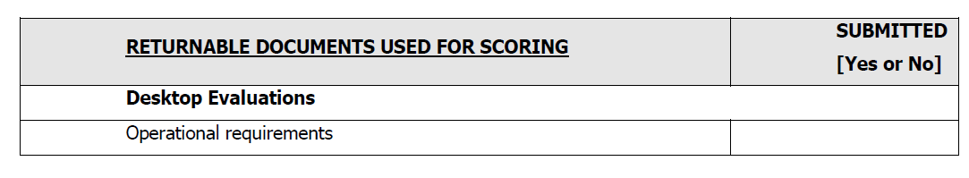
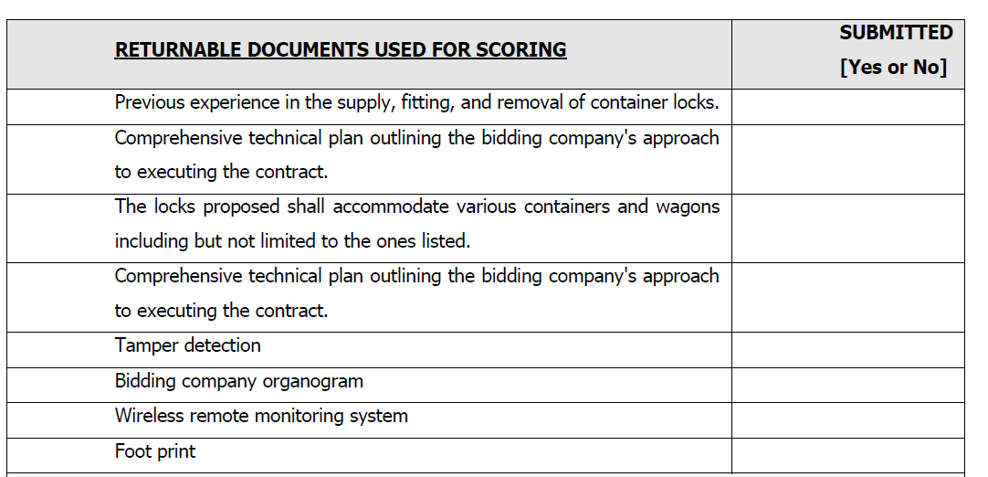
RETURNABLE DOCUMENT

Slide 14
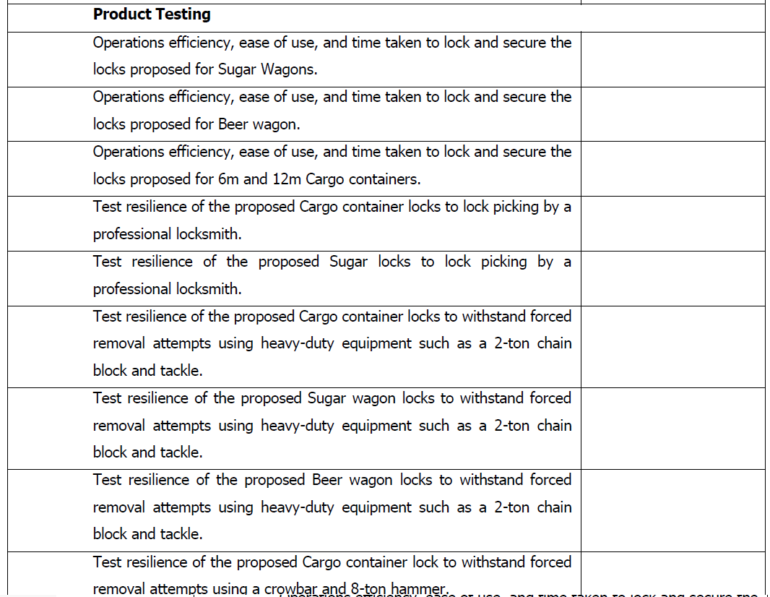
RETURNABLE DOCUMENTS

Slide 15
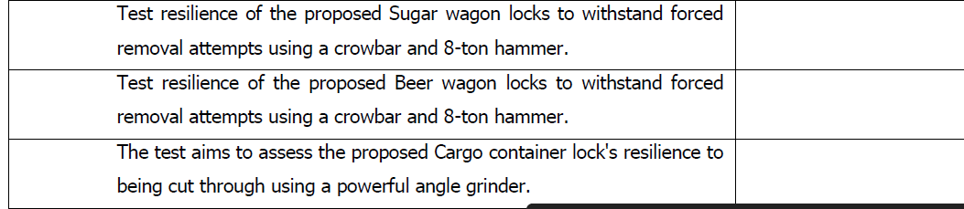
RETURNABLE DOCUMENTS -CONTINUED

Slide 16
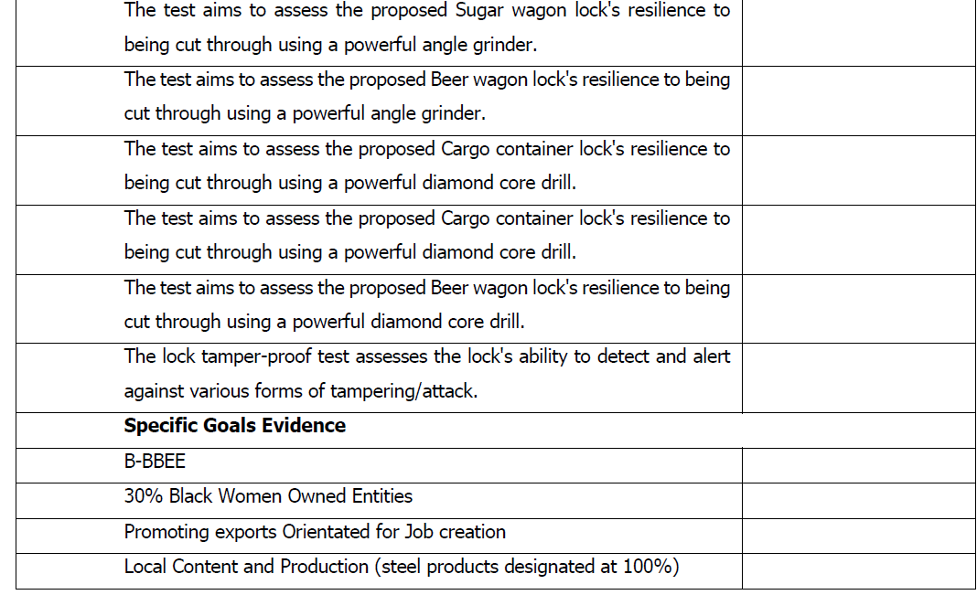

Slide 17
QUESTIONS?

Slide 18
Thank you

